Slide 1
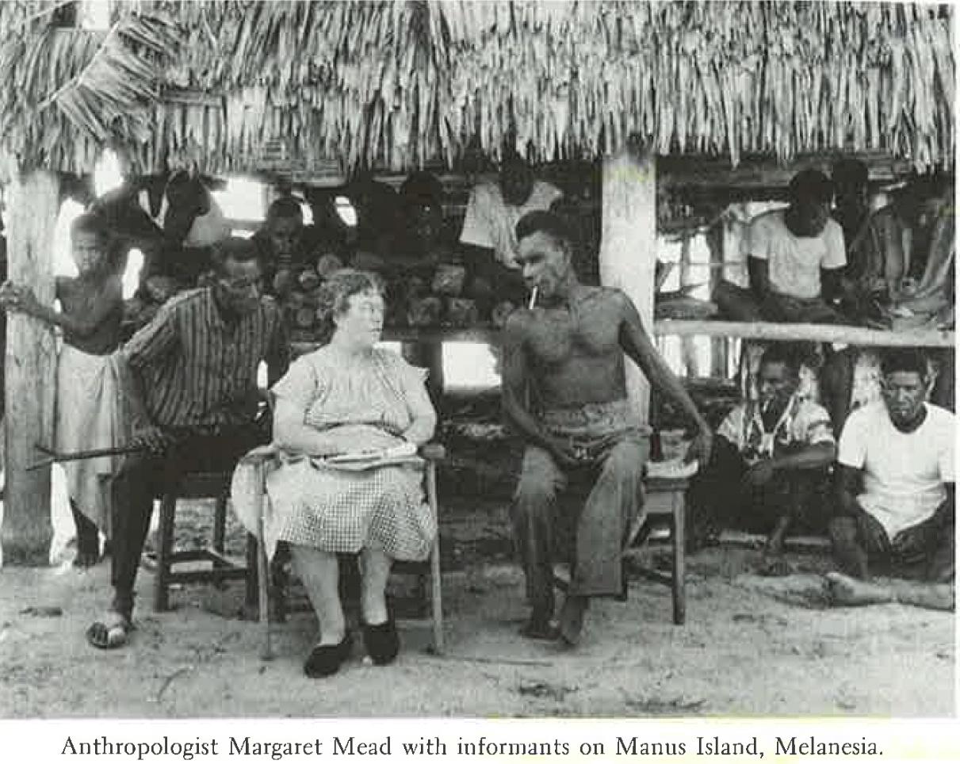
Research Design

Slide 2

Research Design Part 3
Ethnographic Designs

Slide 3

Research Design
Ethnographic Research is a qualitative methodology. It is used for describing analysing and interpreting a culture-sharing groups patterns of behaviour, beliefs, and language that develop over time.

Slide 4
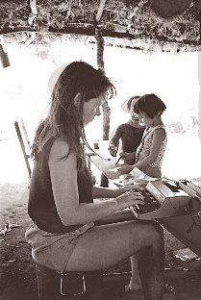
Research Design
You conduct an ethnography when the study of a particular group provides understanding of a larger issue

Slide 5

Research Design
“Ethnography was shaped by cultural anthropology, by an emphasis on the issues of writing about culture, and by how ethnographic reports need to be read and understood today.” p462.

Slide 6
Research Design
Ethnography – Realist Ethnographies is an approach used by cultural anthropologist. They:
1. Narrates the study in the third person in an dispassionate voice and reports on observations of participants and their views.

Slide 7
Research Design
Ethnography – Realist Ethnographies is an approach used by cultural anthropologist. They:
2. The researcher reports objective data in a measured way uncontaminated by personal bias, political goals, and judgement.

Slide 8
Research Design
Ethnography – Realist Ethnographies is an approach used by cultural anthropologist. They:
3.Produce the participant’s views through closely edited quotations and has the final word on the interpretation and presentation of the culture.

Slide 9

Research Design
Ethnography – Case Studies
May focus on a program, event or activity involving individuals rather than group, when they do research a group they are more interested in describing the activities of the group than describing the shared patterns of behaviour exhibited by the group.

Slide 10

Research Design
Case Study
Case study research is less likely to identify a cultural theme to examine at the beginning of a study , especially one from anthropology; instead they focus on an in-depth exploration of an actual case.

Slide 11
Research Design
Case Studies
It is useful to consider the types of cases that qualitative researchers often study:
- Case maybe a single individual, several individuals separately or in groups, a program, events or activities.
- The case may represent a process consisting of a series of steps that form a sequence of activities.

Slide 12
Research Design
Case Studies
It is useful to consider the types of cases that qualitative researchers often study:
- A case may be selected for study because it is unusual and has merit in and of itself. When a study is of interest it is called an intrinsic case. Alternatively the focus of a qualitative study maybe a specific issue. This type of case study is called an instrumental case study because it serves to illustrate a particular issue.

Slide 13
Research Design
Case Studies
It is useful to consider the types of cases that qualitative researchers often study:
- Case studies my also include multiple cases called collective case study.

Slide 14
Research Design
Case Studies
It is useful to consider the types of cases that qualitative researchers often study:
- Case maybe a single individual, several individuals separately or in groups, a program, events or activities.
- The case may represent a process consisting of a series of steps that form a sequence of activities.

Slide 15
Research Design
Case Studies
It is useful to consider the types of cases that qualitative researchers often study:
- The research seeks to develop an in- depth understanding of the case by collecting multiple forms of data. Providing this in-depth understanding requires that only a few cases be studied.

Slide 16
Research Design
Case Studies
It is useful to consider the types of cases that qualitative researchers often study:
- The researcher also locates the case or cases within a larger context, such as geographical, social, political or economic settings.

Slide 17
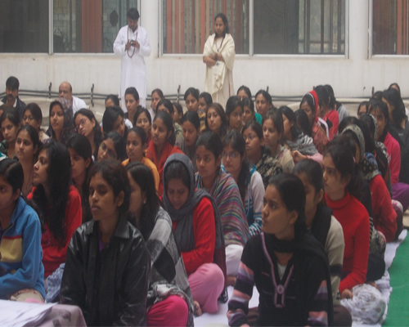
Research Design
Critical Ethnographies
Denzin (1977) Spoke of the twin crisis of representation and legitimation, he was responding to profound changes in American society, such as becoming more multinational, joining the world economy and changing demographics to include more racial groups.

Slide 18
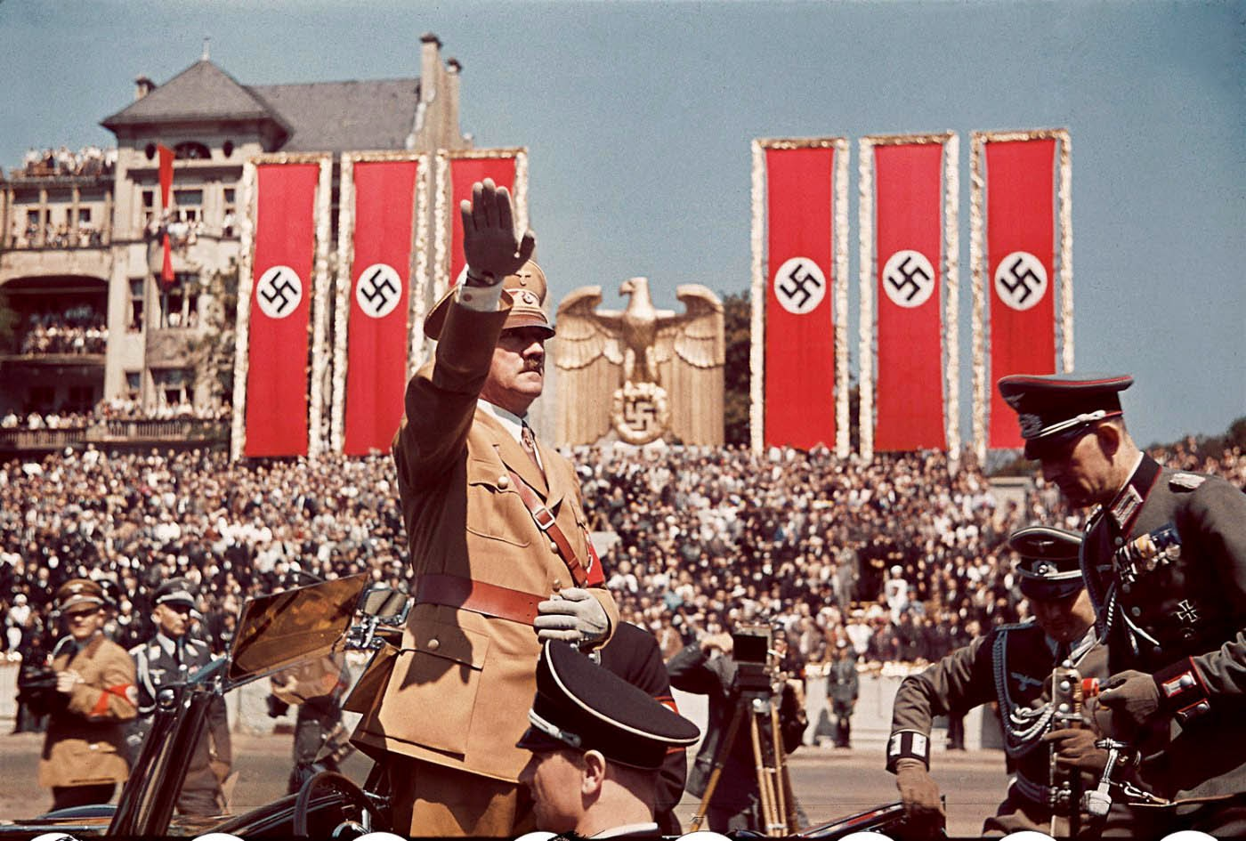
Research Design
Critical Ethnographies
These factors have created a system of power, prestige, privilege and authority that serves to marginalize individuals of different classes, races, and gender in our society. With roots in 1920’s Germany, the historical problems of domination, alienation and social struggle are now playing out with educational and social science research.

Slide 19

Research Design

Slide 20

Research Design
Critical Ethnographies
Are a type of ethnographic research in which the author is interested in advocating for the emancipation of groups marginalized in our society. Typically politically minded individuals who seek through their research, to advocate against inequality and domination.

Slide 21
Research Design
The major components of critical ethnography are factors such as a value laden orientation, empowering people by giving them more authority, challenging the status quo and a concern about power and control.

Slide 22
Research Design
Critical Ethnography
These factors play out in an ethnography in specific procedural characteristics:
- studies social issues of power, empowerment, inequality, inequity, dominance, repression, hegemony, and victimization.

Slide 23
Research Design
Critical Ethnography
- Researchers conduct critical ethnographies so that their studies do not further marginalize the individuals being studied.
- Researcher are self-conscious about their interpretation, recognizing that interpretations reflect their own history and culture.

Slide 24
Research Design
Critical Ethnography
- Researchers position themselves in the text to be reflexive and self-aware of their role, and to be up-front in the written research report.
- This non-natural position for the researcher also means that they will and advocate for change to help transform our society so the people are less oppressed and marginalized.

Slide 25

Research Design
Critical Ethnography
In the end the critical ethnographic report will be a messy, multi-level, multi-method approach to the enquiry, full of contradictions, improbables and tensions.

Slide 26
Research Design
Characteristics of Ethnographic Research
Cultural themes
A culture sharing group
Shared patterns of behaviour, belief and language
Fieldwork
Description, themes and interpretation
Researcher Reflexivity

Slide 27
Research Design
Characteristics of Ethnographic Research
- Cultural Themes in ethnography is a general position, declared to implied, that is openly approved or promoted in a society or group.
- A culture sharing group is two or more individuals who have shared behaviours, beliefs and language.

Slide 28
Research Design
Characteristics of Ethnographic Research
- Shared patterns of behaviour, belief and language. Researchers look for those patterns, they are common social interaction that stabilizes as tacit rules and expectations of the group. Question is how long does a group need to stay together to share.

Slide 29
Research Design
Characteristics of Ethnographic Research
- Fieldwork researchers collect data through spending time in the field.

Slide 30
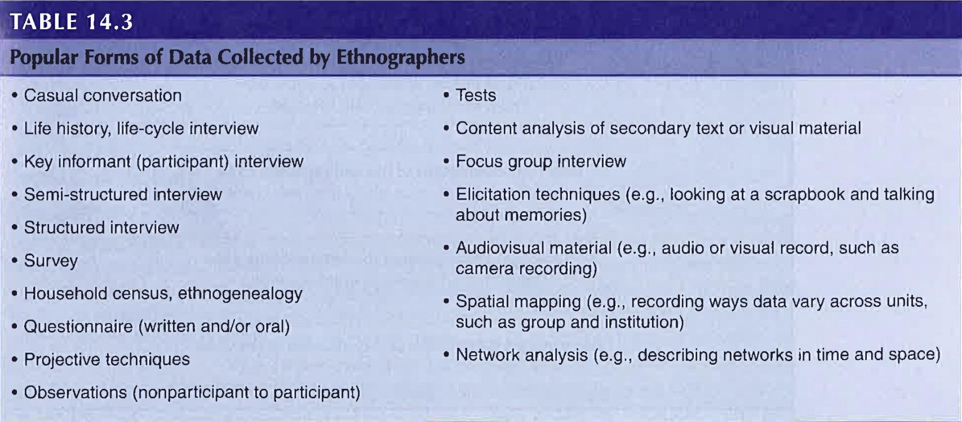
Research Design

Slide 31
Research Design

